Slide 1


MBARARA UNIVERSITY OF SCIENCE AND TECHNOLOGY
Academic Management System
Individual Project Submission — May 2026
Presenter: MURUNGI IAN
Registration ID: 2025/BCS/129/PS

Slide 2
Project Overview
Digitizing academic operations at MUST through a robust relational database for efficiency and data integrity.

Slide 3
Executive Summary
System Efficiency
09
Designed using 3rd Normal Form (3NF) to eliminate data redundancy and manual overhead in record management.
Instant result and transcript processing.
15-20 staff hours saved weekly.
CORE DATABASE TABLES
Automated GPA / CGPA calculation logic.

Slide 4






System User Roles
Administrators
Lecturers
Students
Manage core system entities: Student admissions, Faculty recruitment, and Semester life-cycle configurations.
Input semester marks, monitor assigned course units, and track student performance metrics.
Secure self-service portal to view grades, enrollment status, and download academic transcripts.

Slide 5

Institutional Benefits
Accuracy & Professionalism
The system provides MUST with error-free academic result tracking, significantly fostering a professional and modernized institutional reputation.
Reduces reliance on paper processes, ensuring that student records are accurate, searchable, and always accessible to academic stakeholders.

Slide 6



Risk Management
Database Security
Automated Backups
Integrity Constraints
Strict MySQL user permissions and password hashing implemented to prevent unauthorized access.
Daily scheduled MySQL dumps ensure data recovery in the event of system or hardware failure.
Use of CHECK constraints and ENUM types to prevent invalid data entry (e.g., grades or gender).

Slide 7
Logical Design: Core Entities
Entity Name | Primary Key | Business Role | Key Attribute
Departments | department_id | Academic Unit | dept_name
Programs | program_id | Degree Path | prog_name
Students | student_id | Participant | reg_number
Faculty | faculty_id | Teaching Staff | email_address
Courses | course_id | Curriculum Item | course_code
Grades | grade_id | Result Metric | numerical_grade

Slide 8
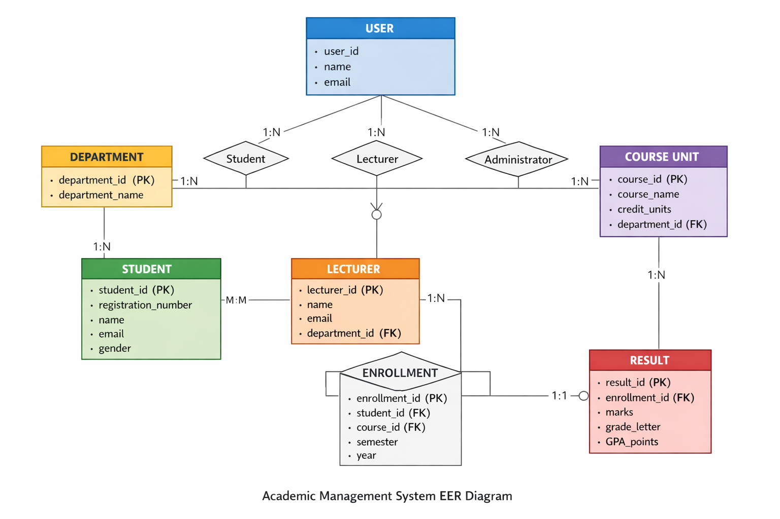
Enhanced Entity Relationship (EER) Diagram
Relational Architecture: 1:N and M:N Junctions with Referential Integrity

Slide 9
Physical Schema (MySQL)
Technical Configuration
Constraints & Types
Built using MySQL 8.0+. All tables utilize AUTO_INCREMENT Primary Keys for record uniqueness and optimized indexing.
UNIQUE: Registration Numbers and Emails.
ENUM: Enforced values for Gender ('Male', 'Female') and Grade Letters (A-F).
Referential Integrity is enforced using Foreign Key constraints with ON UPDATE CASCADE actions.
CHECK: Validates that semester end_dates occur after start_dates.

Slide 10






System Test Data Results
CRUD Validation
Query Execution
Integrity Testing
Verified successful INSERT operations across all 9 tables using realistic MUST university datasets and student enrollment profiles.
Successfully executed 6 complex JOIN queries to validate reporting logic, GPA calculations, and student distribution reports.
Confirmed that Foreign Key constraints and CHECK rules correctly reject invalid data entries (e.g., marks > 100).

Slide 11

Future Roadmap
Digital Evolution
Phase 2 will integrate a secure Laravel-based web interface for remote faculty grading and student profile management via browser.
Phase 3 plans include a mobile application for instant result notifications and a biometric attendance module for tracking.

Slide 12




Questions?
Thank You for Your Attention
Individual Project — MURUNGI IAN
GitHub Repository
Project Demo Video
github.com/murungi-ian-must
Hosted on GitHub / VLE
Mbarara University of Science and Technology | May 2026

